Slide 1


1 Introduction to Machine Learning
Guido Borghi, PhD
guido.borghi@unibo.it

Slide 2
1.1 What is Artificial Intelligence?
Definitions and Applications

Slide 3
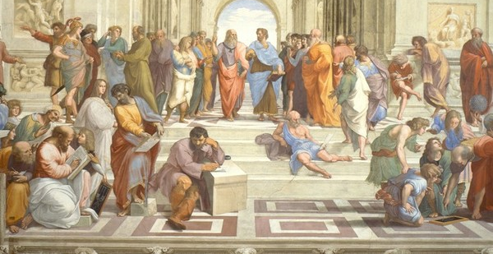
What is Artificial Intelligence?
Finding a proper and general definition of Artificial Intelligence (AI) is complex.
This is because the definition is based on a complex concept: (human) intelligence.
Now the question is: what is Human Intelligence?
For us, as humans, it is intuitive thinking about intelligence.
The definition of intelligent is very subjective
Indeed, there are many definitions of intelligence:
There are many other definitions, humans have been reflecting upon it since at least the times of ancient Greek philosophers!
A very general mental capability that, among other things, involves the ability to reason, plan, solve problems, think abstractly, comprehend complex ideas, learn quickly and learn from experience.¹
1. Gottfredson, Linda S. Mainstream science on intelligence: An editorial with 52 signatories, history, and bibliography. Intelligence (1997)

Slide 4
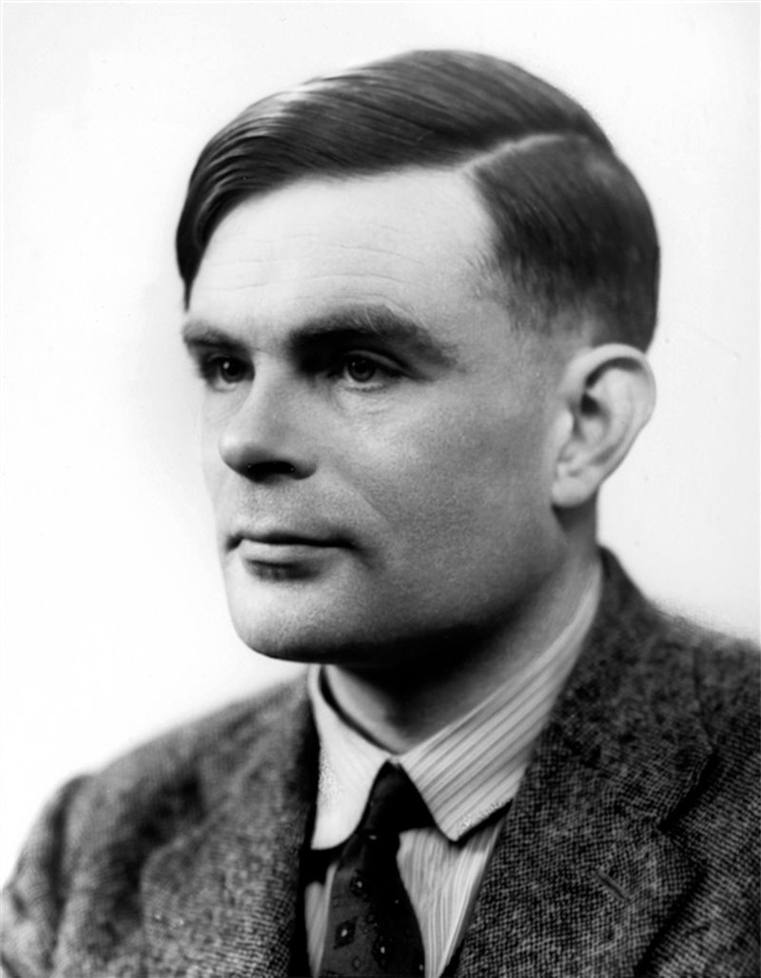
What is Artificial Intelligence?
Then, also for AI there are many definitions, such as¹:
“Simplifying”, we can say that AI is:
The simulation of human intelligence by artificial machines.
We leverage computers for what they excel at: processing vast amounts of data quickly.
This reflects the Turing Test², the first about intelligent machines.
From a practical (as a computer scientist) point of view:
AI is a (huge) set of different disciplines, in which every discipline seeks to simulate a specific human ability / intelligence.
In this set, there is also Machine Learning (the subject of this course!)
It is the science and engineering of making intelligent machines, especially intelligent computer programs…
…but AI does not have to confine itself to methods that are biologically observable.
McCarthy, John. What is artificial intelligence (2007)
Turing, Alan M. Computing machinery and intelligence (1950)
Alan Turing

Slide 5
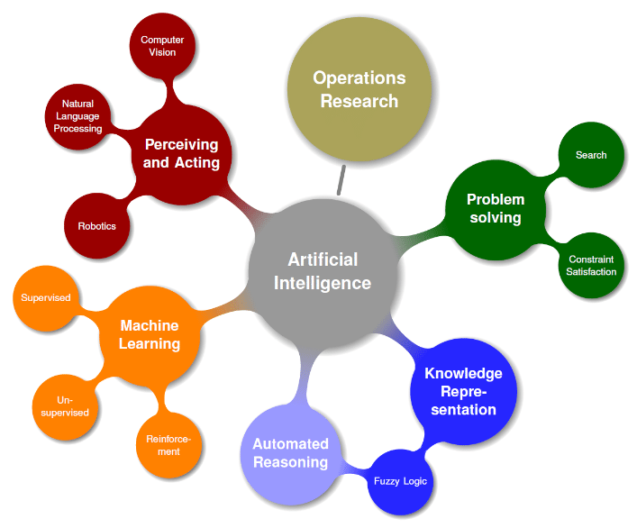
What is Artificial Intelligence?
K. Keppner. Artificial intelligence in supply chain planning – why a hybrid AI concept is the better choice (2018)

Slide 6

What is Machine Learning?
Machine Learning is the field of study that gives computers the ability to learn without being explicitly programmed.
—Arthur Samuel, 1959
A computer program is said to learn from experience E with respect to some task T and some performance measure P, if its performance on T, as measured by P, improves with experience E.
—Tom Mitchell, 1997
https://medium.com/@terdsaksu/artificial-intelligence-machine-learning-deep-learning-a2ebd43ff1b2

Slide 7



What is Artificial Intelligence?
This definition is quite simple, but be aware that:
Simulating human intelligence(s) is extremely complex.
Indeed, our brain is an incredibly sophisticated machine, of which we still know few aspects.
We take for granted activities that are very difficult for a machine to do:
Understanding that in this picture there is a Dalmatian dog
Understanding that in this image the man is not really holding up the tower
Summarizing in a few words a very long book

Slide 8
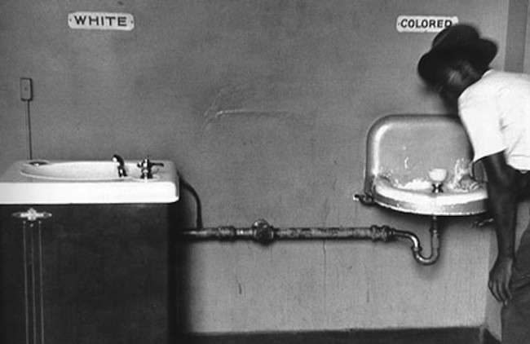
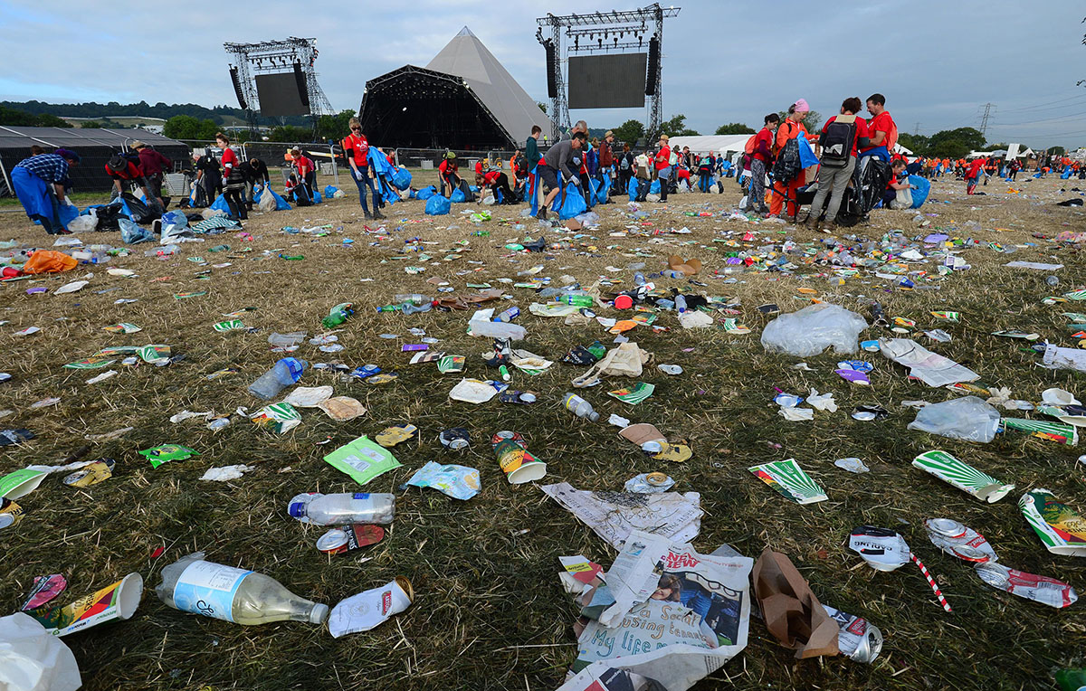

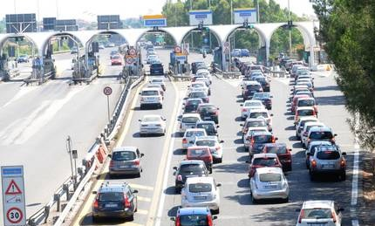

What is Human Intelligence?
To us, it may seem intelligent a system that in reality is not!

Slide 9

Examples of Artificial Intelligence
Probably, the best definition of AI is to see existing examples of AI
One of the best known example of AI is the recent trend of Large Language Models (LLMs)
Chat-GPT (OpenAI - Microsoft)
Bard (Google)
Galactica (Facebook)
…
Numerous are the elements of novelty introduced:
Extensive coverage by traditional media.
User-friendliness (just write something, in any language).
You need a browser only to interact with them.
… but above all, they work well! (and amaze!)
https://chat.openai.com/
https://bard.google.com

Slide 10
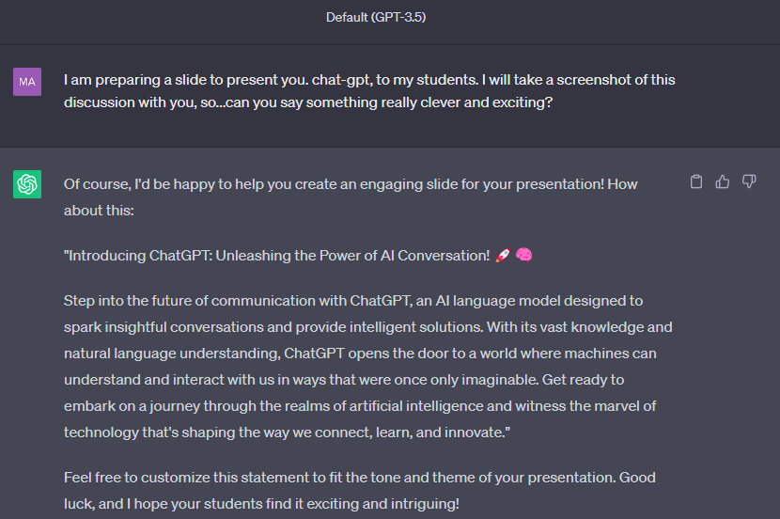
Examples of Artificial Intelligence

Slide 11



Examples of Artificial Intelligence
Other examples of AI
What can you say about these faces?
These faces belong to people who don't exist!
https://this-person-does-not-exist.com/en
https://generated.photos/face-generator/
Try to generate faces yourself!

Slide 12


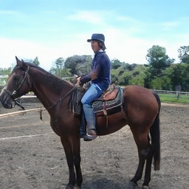
Examples of Artificial Intelligence
https://thiscatdoesnotexist.com
https://thishorsedoesnotexist.com
Try to generate cats and horses yourself!

Slide 13
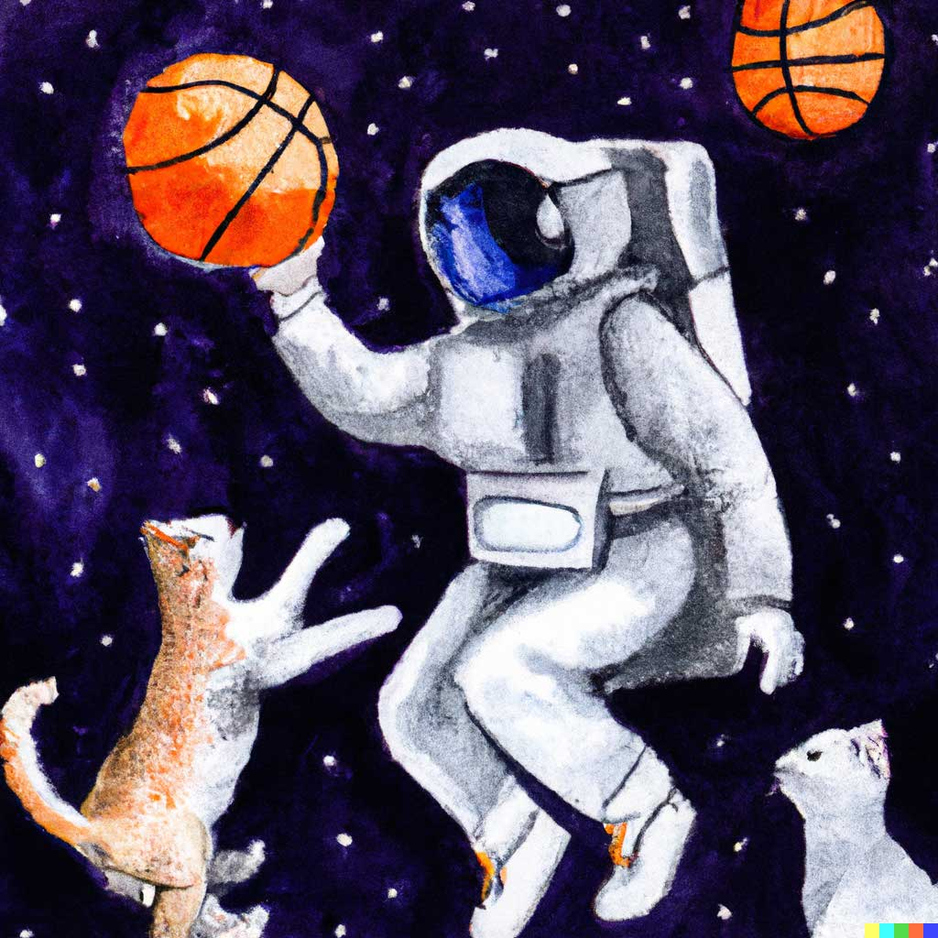
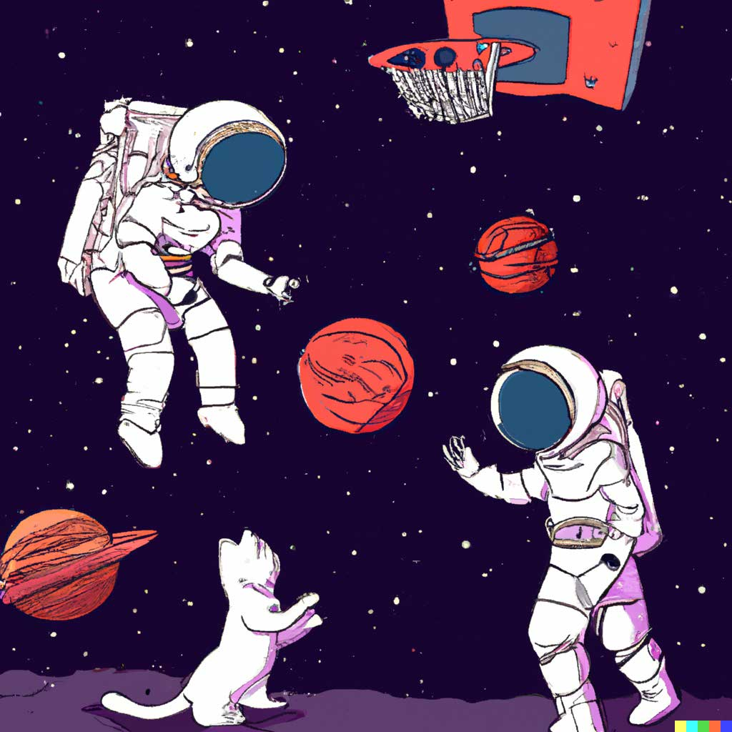
Examples of Artificial Intelligence
An astronaut playing basketball with cats in space as a children's book illustration.
An astronaut playing basketball with cats in space in a watercolor style.
https://openai.com/dall-e-2

Slide 14



Examples of Artificial Intelligence

Slide 15
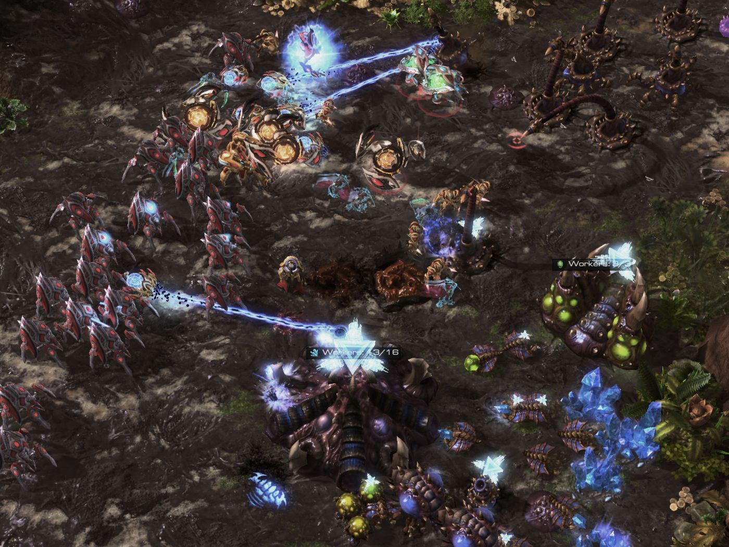
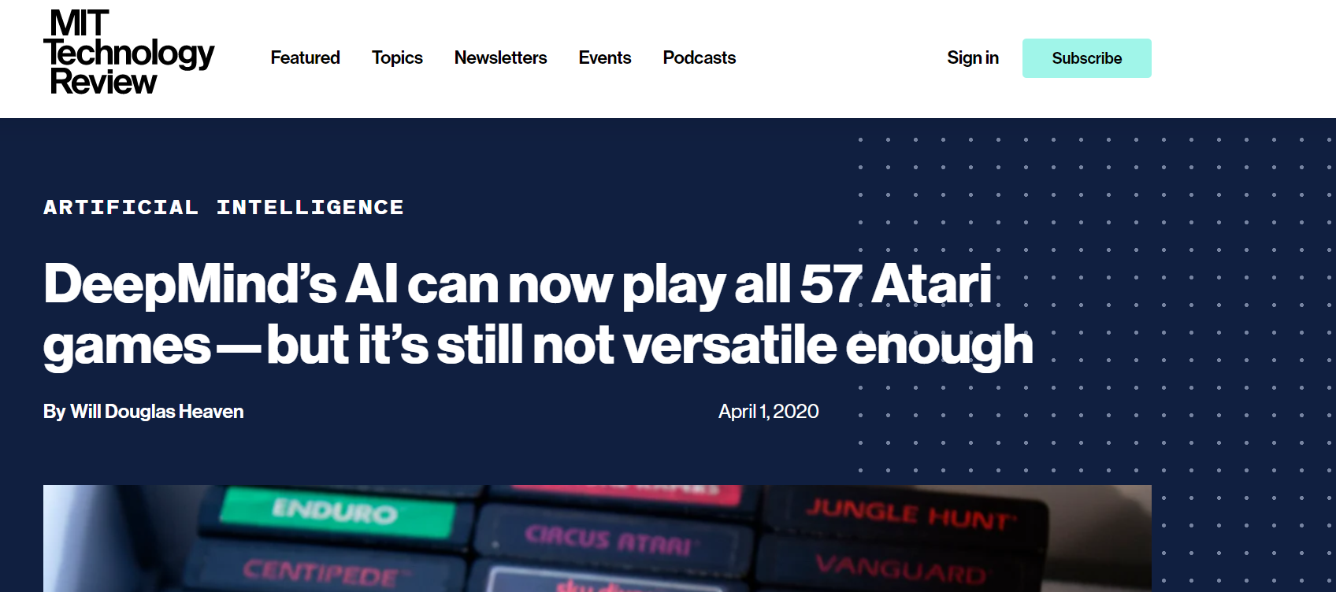
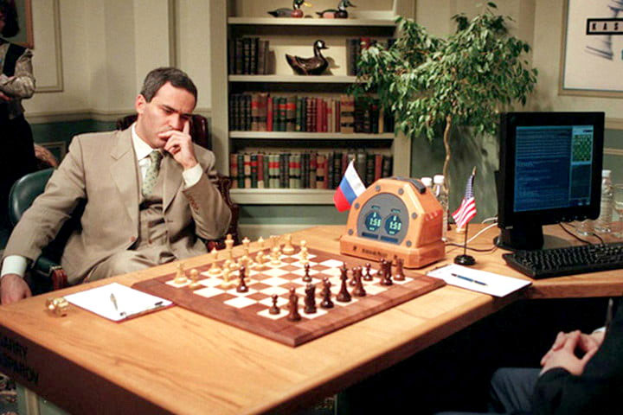
Examples of Artificial Intelligence
AI is now able to play several games and, in some cases, to beat experienced players!

Slide 16
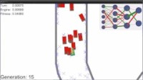
Examples of Artificial Intelligence
AI learns to drive a car by trial and error, each new attempt improves its skills
https://youtu.be/Aut32pR5PQA

Slide 17
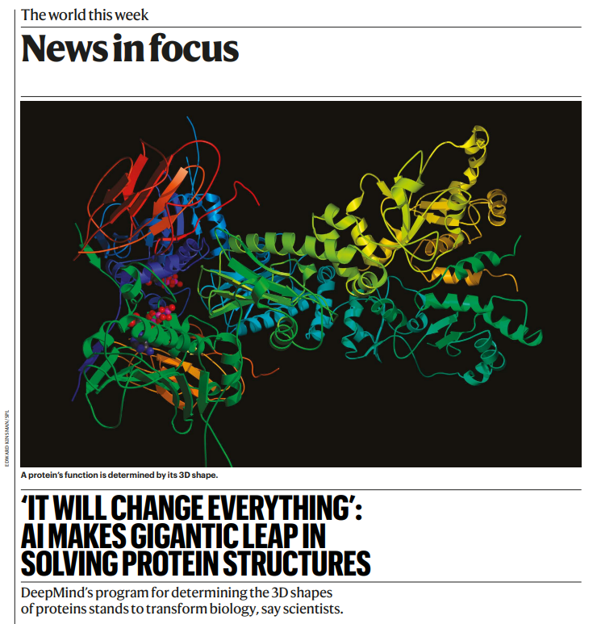
Examples of Artificial Intelligence
AI plays a crucial role also in medicine
https://media.nature.com/original/magazine-assets/d41586-020-03348-4/d41586-020-03348-4.pdf

Slide 18
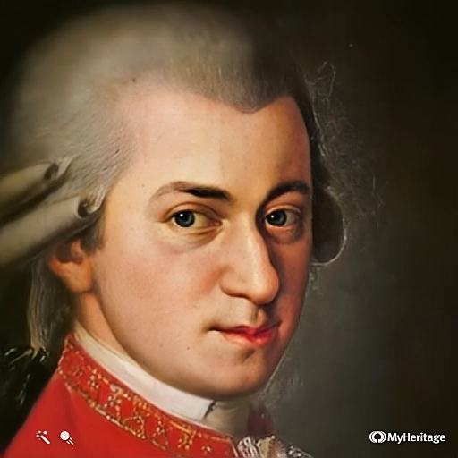
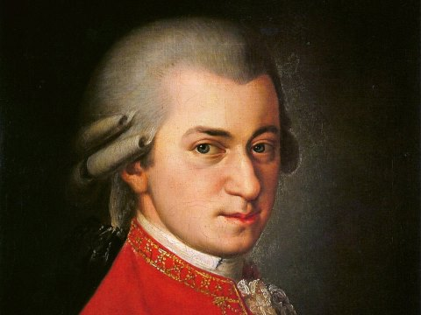
Examples of Artificial Intelligence
AI is able to animate faces in an incredibly realistic way ... does it remind you Harry Potter?
https://www.myheritage.it/deep-nostalgia

Slide 19
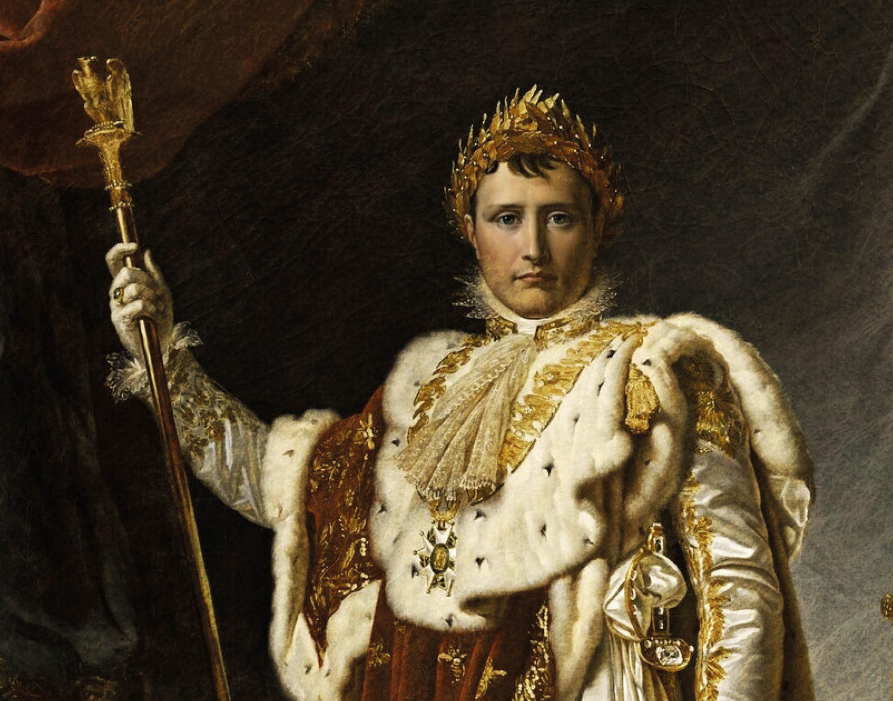

Examples of Artificial Intelligence
https://www.myheritage.it/deep-nostalgia

Slide 20
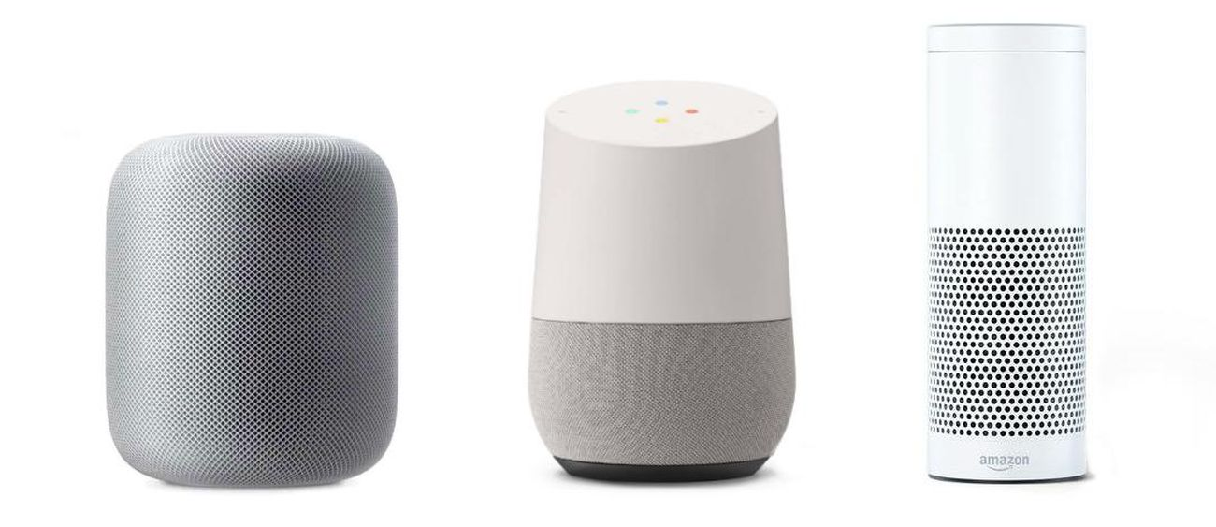
Examples of Artificial Intelligence
Today we have voice assistants who can understand multiple languages

Slide 21
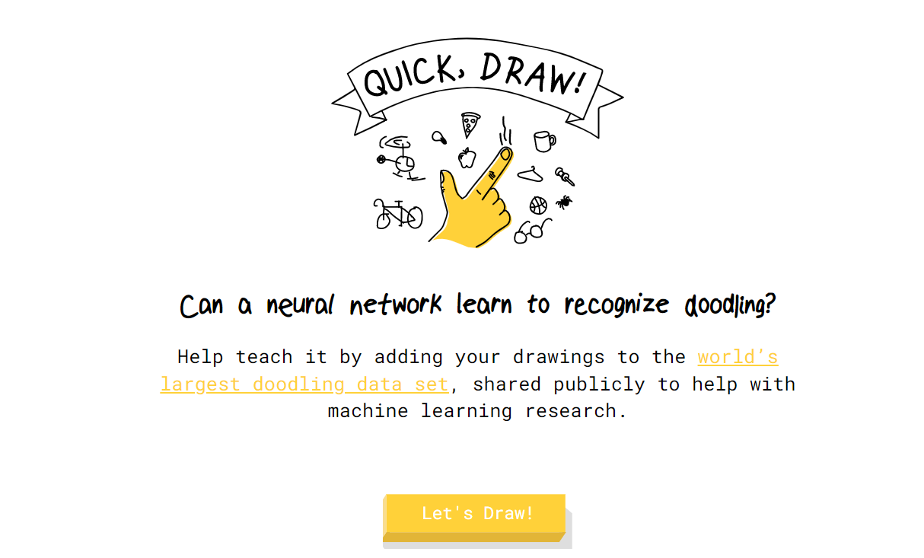
Examples of Artificial Intelligence
https://quickdraw.withgoogle.com/?locale=en_US

Slide 22



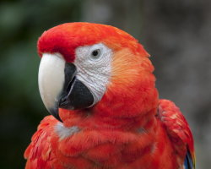


Examples of Artificial Intelligence
Input
Style
Output
Has AI become an artist?
https://deepdreamgenerator.com/

Slide 23

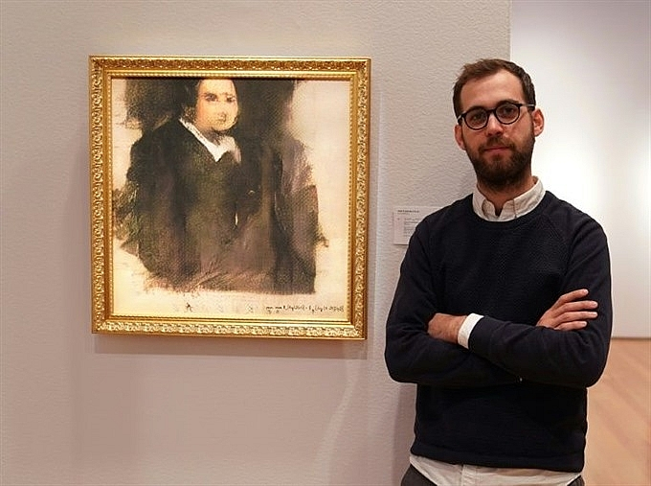

Examples of Artificial Intelligence

Slide 24
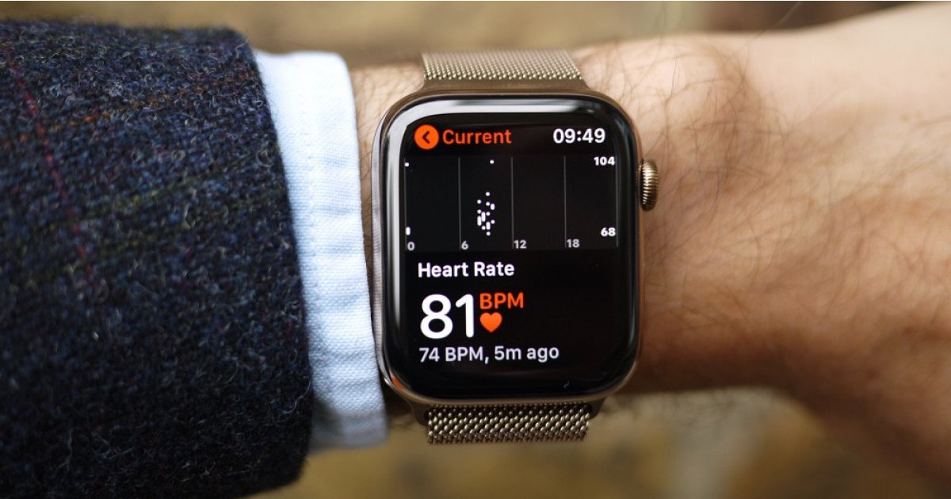

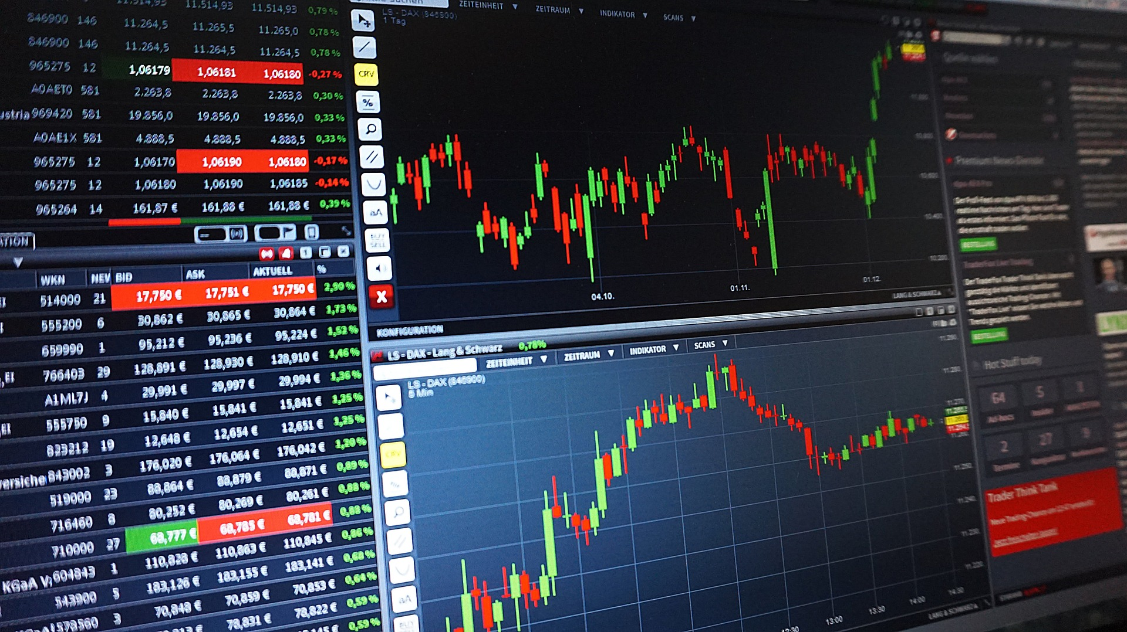
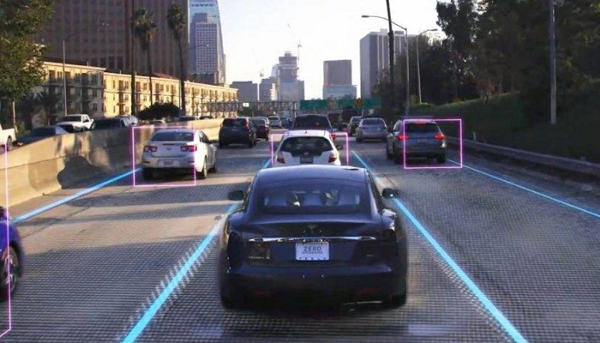
More traditional AI Applications
Data Security
Personal Security
Financial trading
Healthcare
Fraud Detection
Recommendations
Marketing
Online Search
Smart cars
…

Slide 25
More traditional AI Applications
You can find Face Detection in a variety of devices

Slide 26
1.2 The impact of AI in our world
Trends and Companies

Slide 27
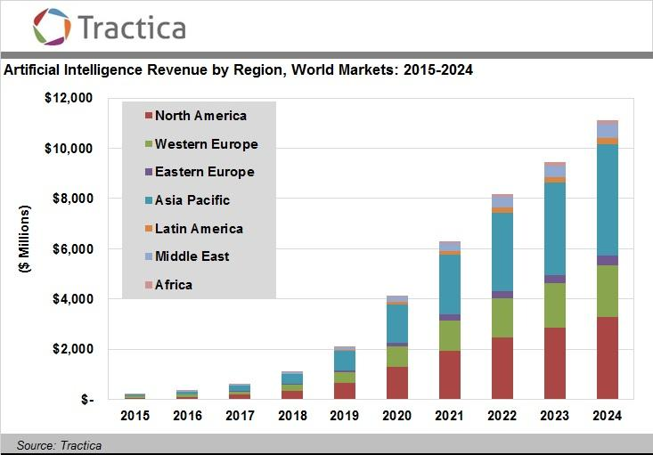
Is AI important today?
For both graphs, note the exponential trend and the variety of continents covered.
Tractica is a market intelligence firm that provides in-depth analysis of global market

Slide 28
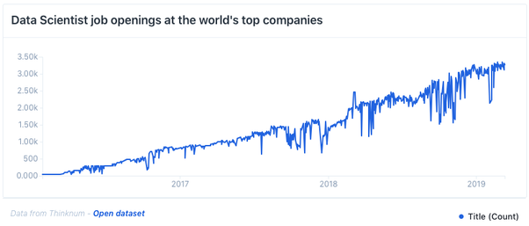
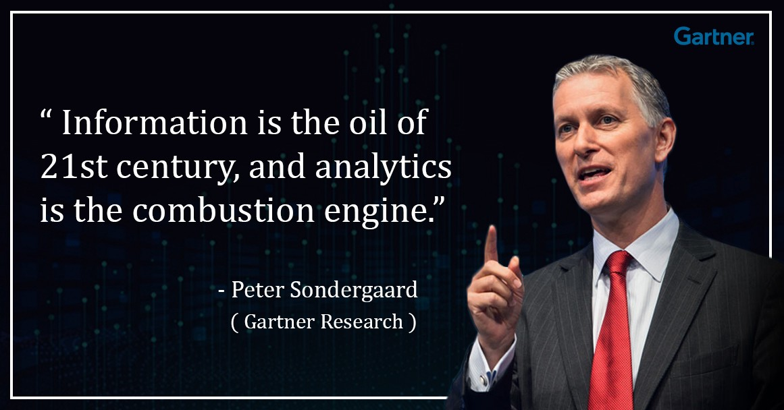
Is AI important today?
The number of requests per position as data scientist (a very general term used to indicate someone who knows how to process and analyze data) is constantly increasing
Companies need to “extract knowledge” from (digital) data to survive!
https://medium.com/dataseries/is-your-data-science-career-dying-c28504d82a8c

Slide 29
Is AI important today?
Interest in these research topics is also high in the academy
A lot of “Machine Learning” courses is available (also online)

Slide 30
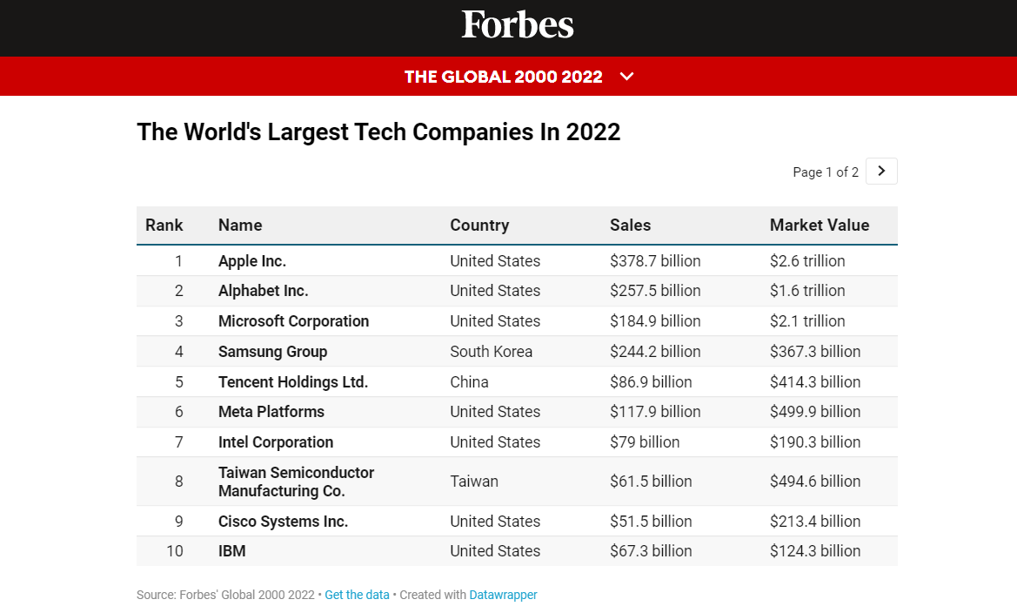
Companies related to AI
The revolution introduced by AI is reflected also in companies.
At least 5 of the top 10 world companies are directly related to AI.
At least 2 companies are directly related to the production of chips, key elements for AI.
Do you know AI applications developed by these companies?

Slide 31

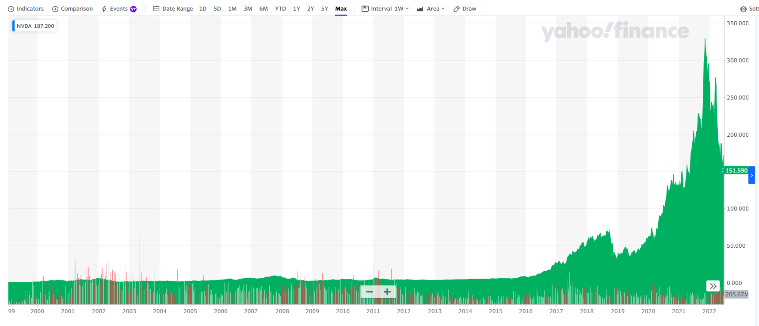
Companies related to AI
Nvidia is a software and fabless company which designs Graphics Processing Units (GPUs)
Nowadays, GPUs are essential to:
“Create” AI models
Perform High Performance Computing (HPC)
Nvidia is the leading company in the sector
That’s why the value of its shares has risen significantly in recent years

Slide 32
1.3 The General Paradigm of Machine Learning
Definitions and Paradigms

Slide 33
Machine Learning
Machine Learning (ML): is a subset of the AI field that tries to develop systems able to automatically learn from specific examples (training data) and to generalize the knowledge on new samples (testing data) of the same domain on a specific task.
From a practical point of view:
We have some data which represent our application domain
We implement an algorithm able to learn from that data (training phase)
We use data (different from the training set) to understand if the trained model has learned something (validation and testing phases) → model deployment
From a (very) practical point of view:
There are several libraries of ML that host already implemented algorithms (it is not necessary to reinvent the wheel every time) → we are going to use scikit-learn (sklearn) for ML
We focus on writing the code needed to use these models
We use Python language → high-level and simple language with whom easily model complex problems
https://scikit-learn.org/stable/

Slide 34
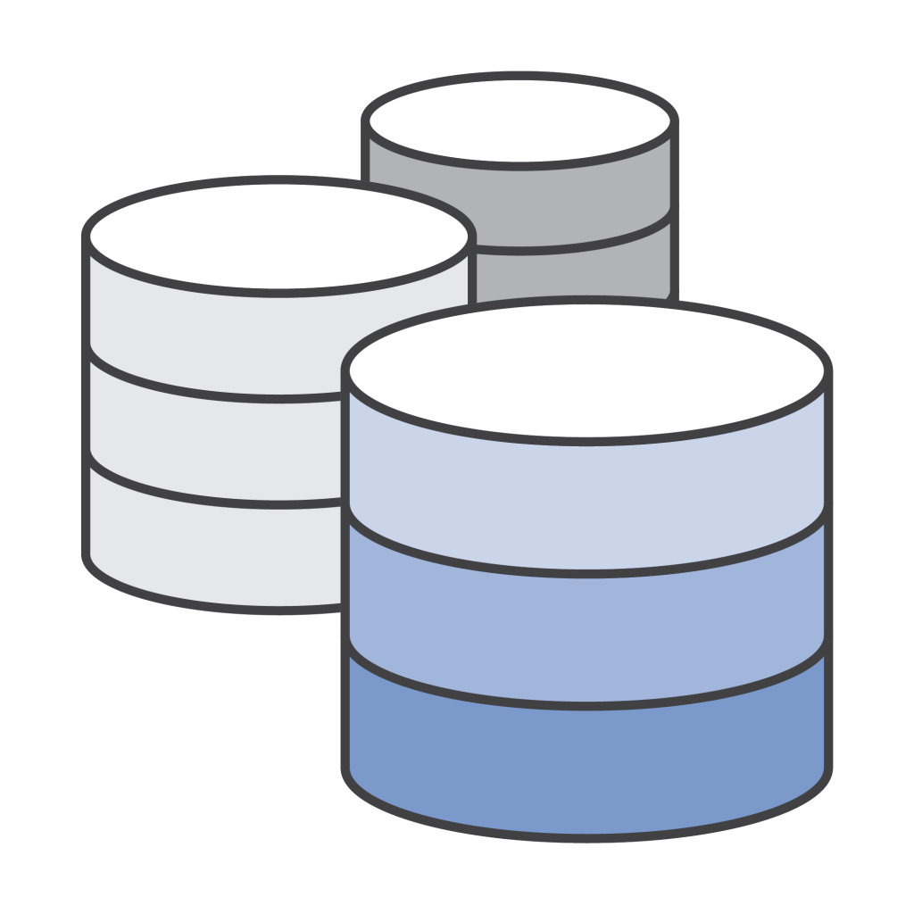

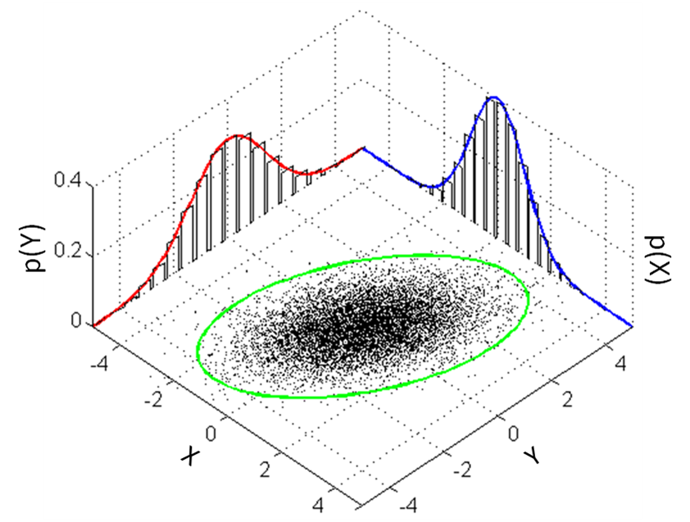
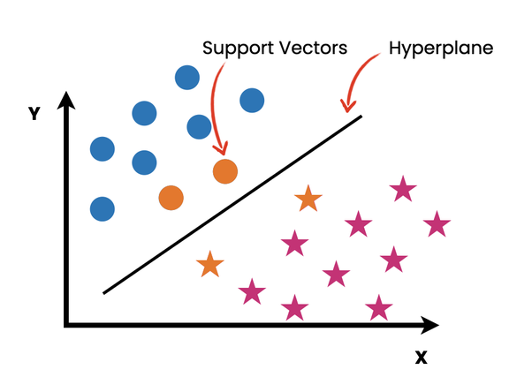
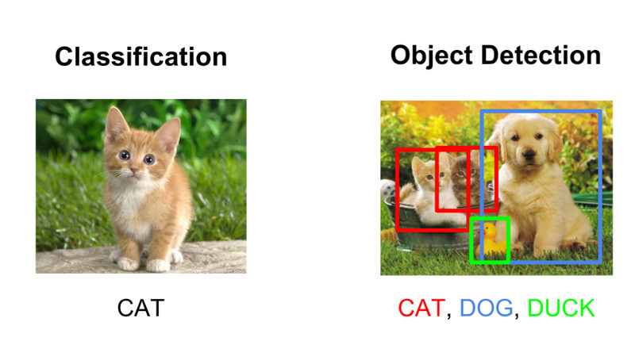
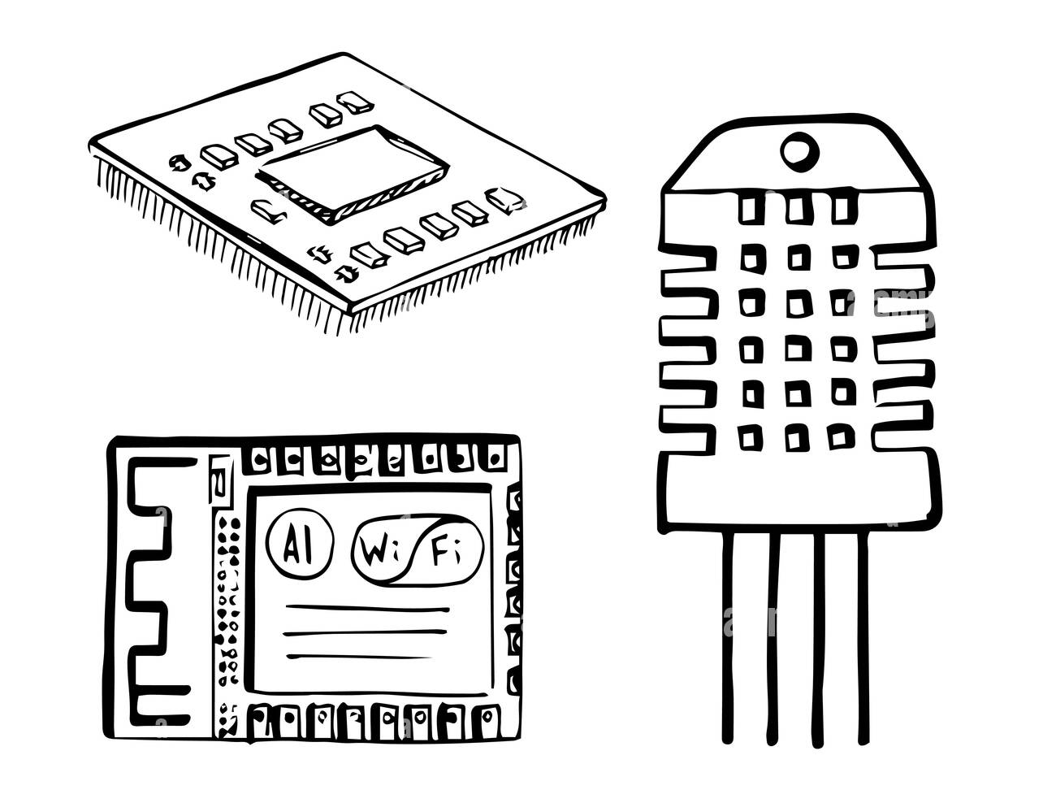
General Paradigm of Machine Learning
These are the main steps for the development intelligent systems based on Machine Learning
It is a simplification of the reality, but it is useful for understanding and studying the discipline
DATA ACQUISITION
DATA PROCESSING
MODEL
PREDICTION
Data

Slide 35
General Paradigm of Machine Learning
Data Acquisition
Data is the founding element of any application related to ML. Acquiring large amounts of data is one of the main focuses of top-companies today.
Data Processing
All those techniques with which data are processed in order to adapt them to the best of the ML model that we plan to develop.
Model
This is the main core of the AI system. A model can be seen as a set of mathematical and statistical techniques (but not only), able to learn from a certain distribution of data (or features) provided in input and to generalize on new data.
Prediction
The output of the model; it can take many forms depending on the application developed. It is important to evaluate the effectiveness of the developed system.
DATA ACQUISITION
DATA PROCESSING
MODEL
PREDICTION

Slide 36
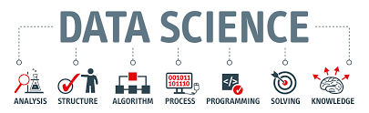
General Paradigm of Machine Learning
Therefore, during the course we will analyze each of the steps just described.
Indeed, learning to implement Machine Learning-based systems means:
Master all the steps described above, from data acquisition to model development
Adapt your knowledge to the application context in which you are (business, academic, ...)
Being able to propose strategies and functional solutions to the problem faced
The reality is often much more complex: it is therefore necessary to understand the theory behind every aspect and every choice, in order to make the right decisions.
But what is "right"? → Often it depends on the context in which we are

Slide 37
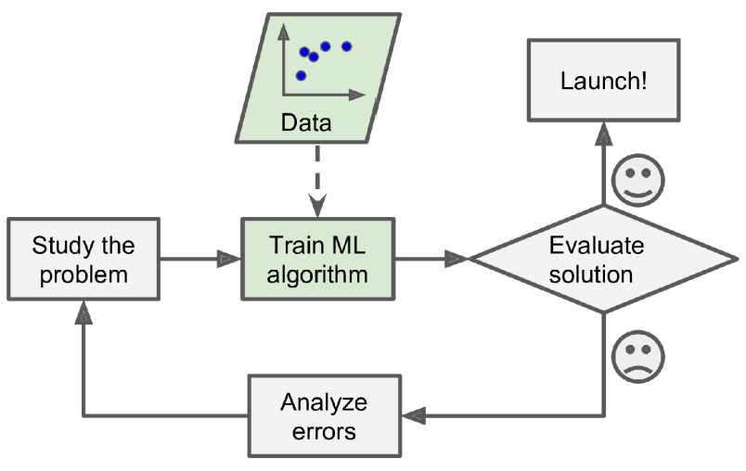
General Paradigm of Machine Learning
The general paradigm can be a bit expanded
After the ending of this course, I hope you will able to properly:
Study and analyze the problem
Decide to use the proper ML/DL algorithm
Evaluate the solution
Analyze errors
This (brief) course is for you only a starting point in which you are provided with many of the tools then necessary to approach new techniques, new algorithms, new programming tools, …

Slide 38
1.4 Historical evolution of AI
AI seasons

Slide 39
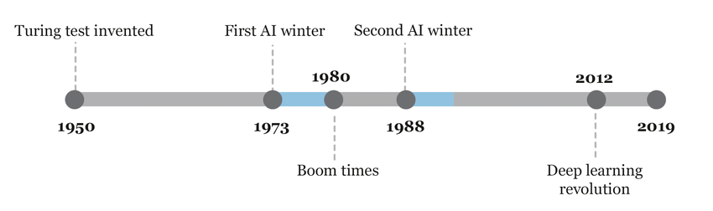
Why AI is so important today?
To understand why AI is so important today, we have to analyze the past
In other words, we have to study the past to better understand current times

Slide 40
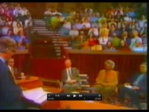
A brief history of AI
1950: initial enthusiasm for AI
Turing Test: first resarches on intelligence applied to machines
1954: one of the first experiments in machine translation was executed
1955: Arthur Samuel wrote a program that could play checkers very well
1957: Rosenblatt invented perceptrons, the seed of modern neural networks
→ tremendous hype and huge funding (thanks to also the Cold War)
First AI winter
McCarthy: «AI is harder than we thought!»
Hutchins: «the quiet decade of machine translation»
Minsky and Papert proved that perceptrons could only be trained to solve linear separable problems. Mathematical problems limit the adoption of more layers to solve non-linear problems.
1973: promises of AI researchers were exaggerated (Lighthill report)
https://youtu.be/03p2CADwGF8

Slide 41
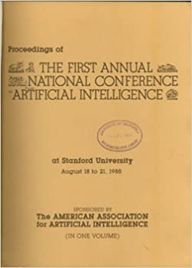

A brief history of AI
1980: Boom times
Commercialization of new AI Expert Systems capable of reproducing human-decision making, through “if-then-else” rules (manually developed rules!)
Fields: financial planning, medical diagnosis, geological exploration, and microelectronic circuit design
Large conferences, like AAAI started
Second AI winter
Many tasks were too complicated for engineers to design rules around them manually
Decrease in funding in AI research
Market of Lisp machines collapsed (hardware limitations):
Lisp: symbolic high-level programming language with huge computational requirements
List machines: computer designed specifically to develop and run large artificial intelligence programs
Commercial hardware was designed and optimized for assembly- and Fortran-like programming languages

Slide 42
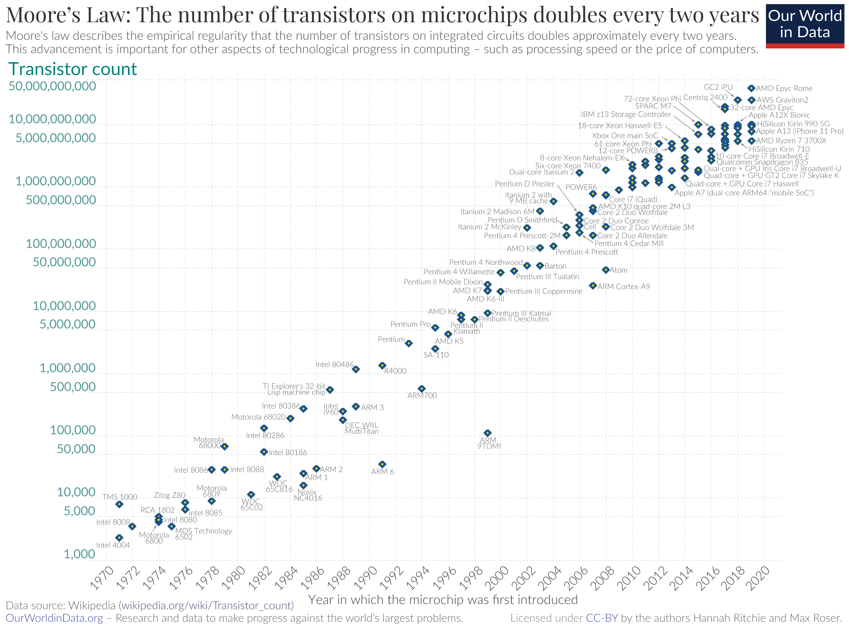
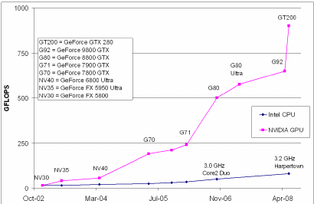
A brief history of AI
2012: Deep Learning revolution!
Solved mathematical problems
In 1975, Werbos's backpropagation algorithm introduced
1986: backpropagation algorithm adapt for neural networks by Rumelhart, Hinton & Williams → enabled practical training of multi-layer networks!
New powerful Neural Networks → CNNs, GANs, …
Huge improvement with the computational power
Recall all the aspects seen in my module on Computer Architectures, in particular the Moore’s Law
Tremenoud advances in chip creation, circuit development, …
Introduction of GPUs!
First GPU announced in 1999 by Nvidia

Slide 43
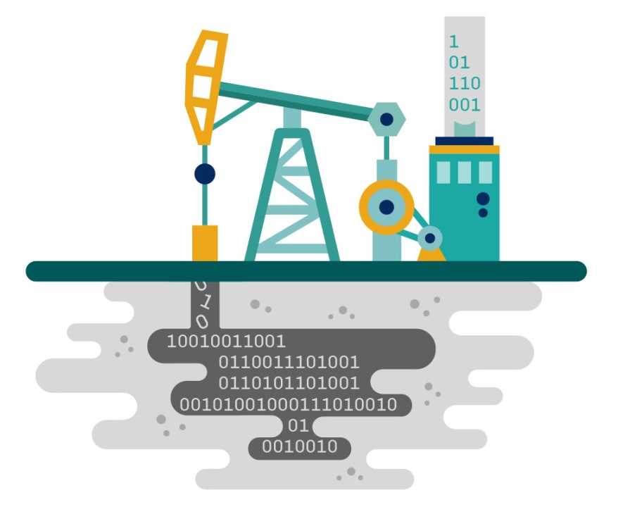
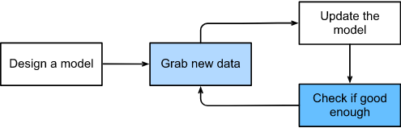
A brief history of AI
«Solved» problem with data
AI models need huge amount of training data
Currently, we are able to:
Acquire a lot of data → IoT technlogies
Store huge amount of data → Improvements in storages
Today, data are extremely important: «Data is the new oil»
Today, the question is not if we are able to collect data, but if we are able to use them
The common development of an AI model in a company revolves around data, and acquiring new data is a fundamental part.

Slide 44
Future is now!
The “AI revolution” started about 10 years ago
Right now, AI from an academic research topic is becoming a business reality
It is time to strike while the iron is hot!
There is a need for professionals who know how to manage this process

Slide 45
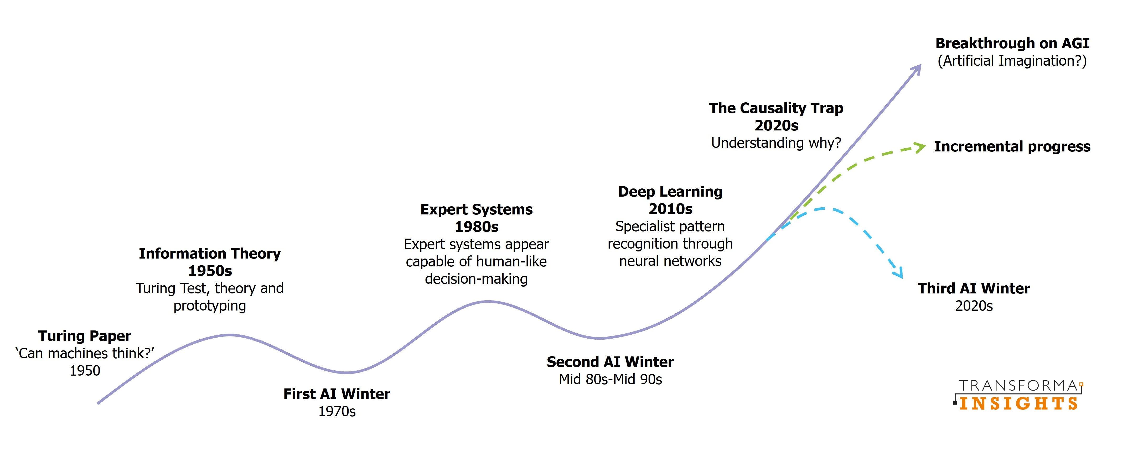
Future is now!

Slide 46
1L Laboratory
Introduction to Colab

Slide 47





Some notes about Lab
+
In our lab exercises:
We will program with Python language
We will use Colab as programming tool
However, you can use other IDEs (Integrated Development Environment), such as:
PyCharm,
Visual Studio Code
Jupyter Notebook / Lab
I have selected a small amount of code, which you have to learn very well because it is the basis of any ML project (I prefer a pragmatic approach):
Do not execute code without understanding it, always try to find an explanation for what you have created
It is necessary to "play" a lot with the code to become familiar:
Play → modify small pieces of code, variables, parameters to see their effects
Play → check that you understand correctly how methods and functions work
Bugs can be very informative

Slide 48
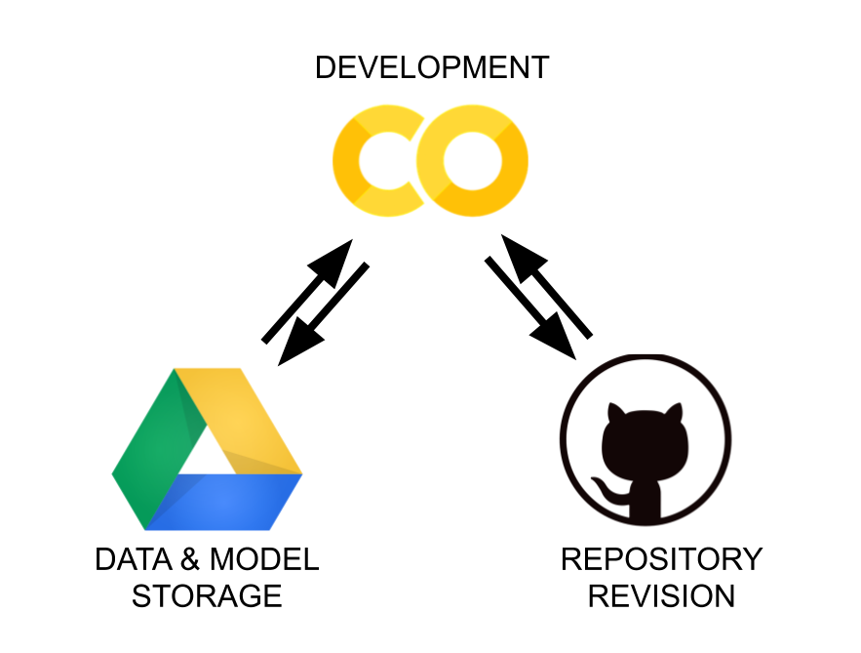
Colab
Free Google service
You can use your institutional email (@studenti.unibo.it) or other
Easy to use, the environment provided already has most of the resources installed
The code runs in your browser
You don't have to install anything!
In reality, the code runs on virtual machines within Google's data centers
External resources can be accessed also through your Google Drive account
Each assigned virtual machine has a variable hardware equipment:
CPU and RAM available depending on daily demand
It is also possible to have GPU resources
In case of special hardware needs, you are asked to use the paid version
It is an example of PaaS / SaaS, in short, a cloud resource made available by Google

Slide 49
Alternatives to Colab
As mentioned, you can use alternatives to Colab:
It is not certain that it will be able to give you technical support in case of difficulties with installations or other
I use Colab mainly for teaching purposes, PyCharm for my scientific research
Jupyter Notebook / Lab
Similar to Colab (rather, Colab is based on Jupyter Notebook)
The code runs on your own computer (not on a virtual machine)
You are responsible for your installations
Pycharm
Free IDE widely used
More complex to learn, but you are using a professional instrument
In both cases, you need a Nvidia GPU on your computer (only) for the DL module

Slide 50
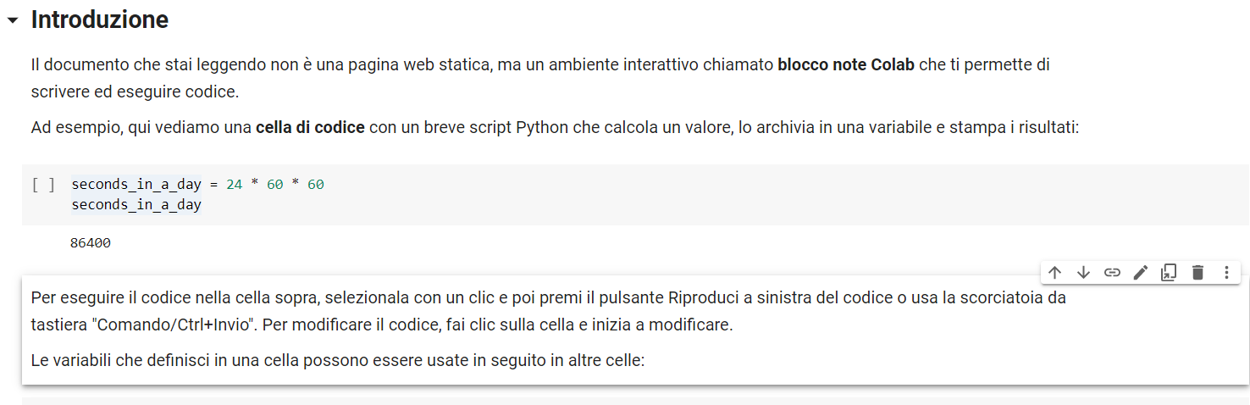
Hands on Colab
https://colab.research.google.com
The web page is divided in 2 types of cells:
Text: block in which I have inserted the explanations and in which you can take notes
Code: block executable via Ctrl + Enter (or by clicking on the triangle on the left)
The variables are visible from the other cells
It is possible to visualize the output of each cell
External resources can be accessed via:
Upload (but they will be removed at each new start)
Google Drive
The resource must be mounted on the virtual machine
This process must be repeated at every start
Beware that you have (only) 15 GB on Google Drive
The decision is up to you!

Slide 51
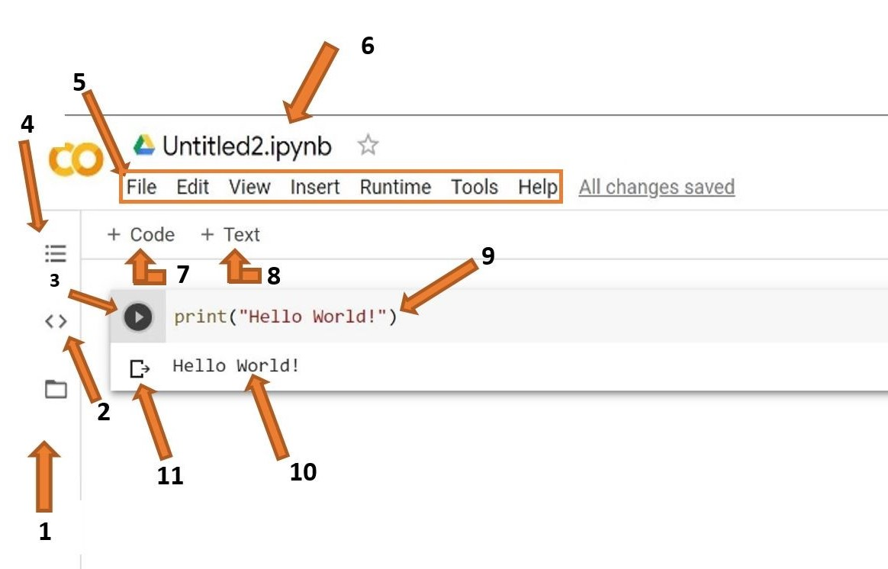
Hands on Colab
Files: Here you will be able to upload datasets and other files from both your computer and Google Drive
Code Snippets: Here you will be able to find prewritten snippets of code for different functionalities like adding new libraries or referencing one cell from another.
Run Cell: This is the run button. Clicking this will run any code that is inserted in the cell beside it. You can use the shortcut shift+enter to run the current cell and exit to a new one.
Table of Contents: Here you will be able to create and traverse different sections inside of your notebook. Sections allow you to organize your code and improve readability.
Menu Bar: Like in any other application, this menu bar can be used to manipulate the entire file or add new files. Look over the different tabs and familiarize yourself with the different options. In particular, make sure you know how to upload or open a notebook and download the notebook (all of these options are under “File”).
File Name: This is the name of your file. You can click on it to change the name. Do not edit the extension (.ipynb).
Insert Code Cell: This button will add a code cell below the cell you currently have selected.
Insert Text Cell: This button will add a text cell below the cell you currently have selected.
Cell: This is the cell. This is where you can write your code or add tex..
Output: This is the output of your code, including any errors, will be shown.
Clear Output: This button will remove the output.
https://runestone.academy/ns/books/published/httlads/PythonReview/google_colab.html

